Slide 1
Chapter 8
Market Segmentation, Targeting and Positioning

Slide 2
Benefits of Segmentation
Effective use of resources
Gain a focus
Create Value for a target market
Positioning

Slide 3
Steps in Market Segmentation, Targeting, and Positioning
Market Segmentation
1. Identify bases for
segmenting the market
2. Develop segment profiles
Market Targeting
3. Develop measure of
segment attractiveness
4. Select target segments
Market Positioning
5. Develop positioning for
target segments
6. Develop a marketing
mix for each segment

Slide 4
Step 1. Market Segmentation
Levels of Market Segmentation
Mass Marketing
Same product to all consumers
(no segmentation, i. e. a commodity)
Segment Marketing
Different products to one or more segments
(some segmentation, i.e. Marriott)
Through Market Segmentation, Companies Divide Large, Heterogeneous Markets into Smaller Segments that Can be Reached More Efficiently And Effectively With Products and Services That Match Their Unique Needs.

Slide 5
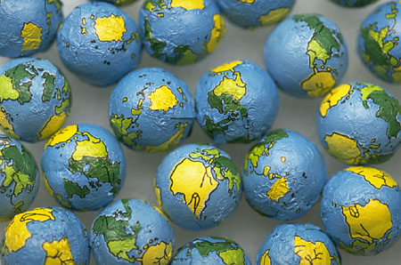
Step 1. Market Segmentation
Geographic Segmentation
International
Accor
National
Regional/City

Slide 6
Step 1. Market Segmentation
Demographic Segmentation
Dividing the market into groups based on variables such as:
  Age
  Gender
  Family size or life cycle
  Income
  Occupation
  Education
  Religion
  Race
  Generation
  Nationality
Most Popular Bases & Easiest to Measure

Slide 7
Step 1. Market Segmentation
Psychographic Segmentation
Divides Buyers Into Different Groups Based on:
Social Class
Lifestyle
Personality

Slide 8
Step 1. Market Segmentation
Behavioral Segmentation
Dividing the market into groups based on variables such as:
  Occasions
  Benefits
  User status
  Usage rate
  Loyalty status
  Readiness stage
  Attitude toward product

Slide 9
Step 1. Market Segmentation
Segments must respond differently to different marketing mix elements & programs
Requirements for effective segmentation
Measurable
Accessible
Substantial
Size, purchasing power, profiles
of segments can be measured.
Actionable
Segments can be effectively
reached and served.
Segments are large or profitable enough to serve.
Effective programs can be designed to attract and serve the segments.

Slide 10
Evaluating Market Segments
Segment size and growth
Segment structural attractiveness
Company objectives and resources

Slide 11
Step 2. Market Targeting
Market Coverage Strategies
Company
Marketing
Mix
Market
A. Undifferentiated Marketing
Company
Marketing Mix 1
Segment 1
Company
Marketing Mix 2
Segment 2
B. Differentiated Marketing
Company
Marketing Mix 3
Segment 3
Segment 1
Company
Marketing
Mix
Segment 2
Segment 3
C. Concentrated Marketing

Slide 12
Choosing a market-coverage strategy
Company resources
Degree of product homogeneity
Market homogeneity
Competitors’ strategies

Slide 13
Step 3: Positioning for Competitive Advantage
Product’s Position - the way the product is defined by consumers on important attributes - the place the product occupies in consumers’ minds relative to competing products.
Marketers must:
  Plan positions to give their products the greatest advantage in selected target markets

Slide 14
Positioning Strategies
Positioning by specific product attributes
Positioning by benefits
Positioning for user category
Positioning for usage occasion
Positioning against another competitors
Positioning against another product class

Slide 15
Steps to Choosing and Implementing
a Positioning Strategy
Step 1. Identifying Possible Competitive Advantages: Competitive Differentiation.
Step 2. Selecting the Right Competitive Advantage: Unique Selling Proposition (USP).
Step 3. Communicating and Delivering the Chosen Position.

Slide 16
Product Differentiation
Physical attributes
Service differentiation
Personnel differentiation
Location
Image differentiation

Slide 17
Which differences to promote?
Important to customers
Distinctive
Superior
Communicable to customers
Preemptive
Affordable
Profitable

Slide 18
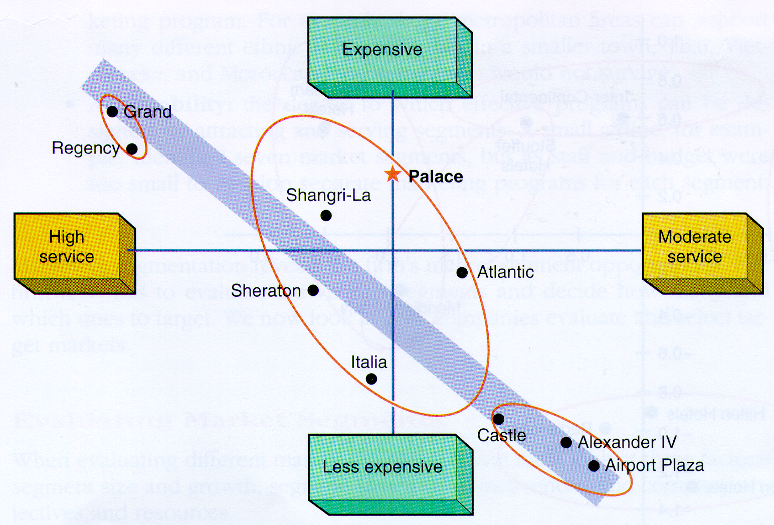
Perceptual Map
Positioning map of service level versus price. Source: Lovelock, Services Marketing, Prentice Hall

Slide 19
Perceptual Map
Live shows
1.0
0.8
0.6
0.4
0.2
Easy to reach
Little waiting
Good food
Fantasy
Educational,
animals
Exercise
Marineland
of the
Pacific
Fun rides
Knott’s
Berry
Farm
Japanese
Deer Park
Disneyland
-1.6 -1.4 -1.2 -1.0 -0.8 -0.6 -0.4 -0.2
0.2 0.4 0.6 0.8 1.0 1.2 1.4 1.6
-0.2
-0.4
-0.6
-0.8
Magic
Mountain
Lion
Country
Safari
Busch
Gardens
Economical

